Slide 1
CV ANALYZER

Slide 2


Slide 3
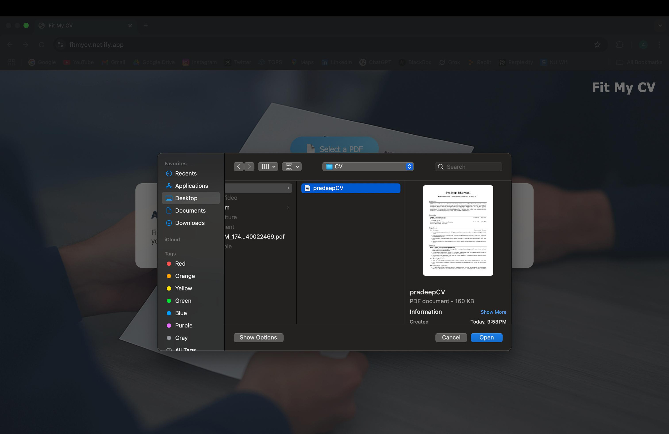

Slide 4
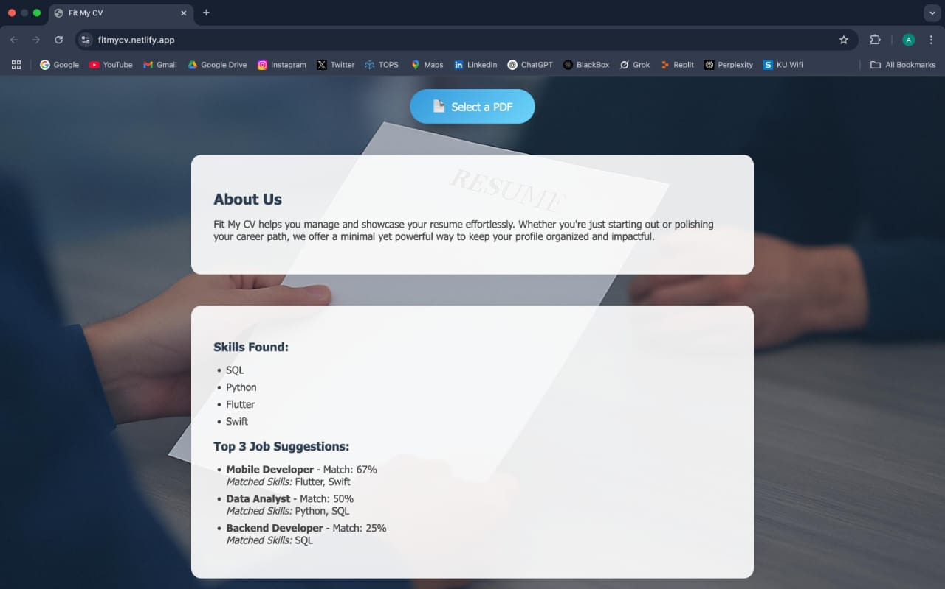

Slide 5

Krish Dhairav
(202407020395)
Shah Chaitya (202407030475)
Henish Prajapati (202407020383)
Guided by: Prof. Roshni Ramnani Subject: Applied AI

